Slide 1

AWS REDSHIFT & POSTGRESQL
SHOWING THE SYMBOTIC RELATIONSHIP

Slide 2
AGENDA
CONNECT
DEMO
LinkS
When files uploaded to US bucket, they are not being replicated to Australia bucket. What could be the reason?

Slide 3


Robert Koch “ROB”
Newly minted AWS Database Hero
(Thank you AWS!!)
Economics major, fell into software
Deaf – American Sign Language’s my primary language
Passionate about workflow/processes
Current status
Work at S&P Global Platts (almost 10 years)
Primarily work with energy data
Architecture, workflow, data, analytics
Which AWS service would simplify migration of a database to AWS?

Slide 4


Differences
Amazon RedShift (MPP)
Column store
OLAP: Analytics
Fast Aggregates
PostgreSQL (RDMS)
Row store
OLTP: Transactional data
Fast Reads/Writes
Amazon RedShift
Why is AWS more economical than traditional data centers for applications with varying compute workloads?

Slide 5

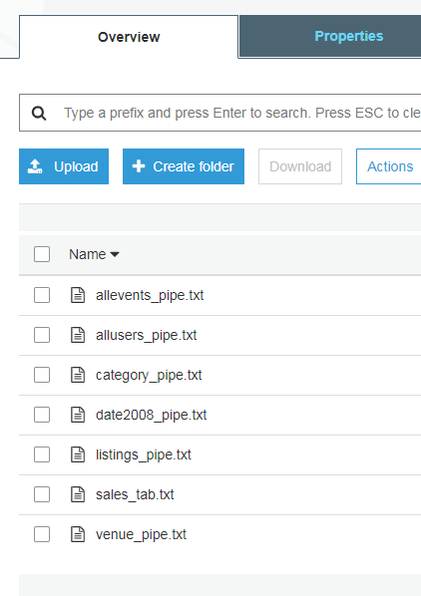
Connect
Steps I took:
Download SQL Workbench/J
http://www.sql-workbench.eu/downloads.html
Download PostgreSQL driver (jar)
https://jdbc.postgresql.org/download.html#current
Download Amazon RedShift driver (jar)
https://s3.amazonaws.com/redshift-downloads/drivers/jdbc/1.2.36.1060/RedshiftJDBC42-no-awssdk-1.2.36.1060.jar
A data engineer needs to collect data from multiple Amazon Redshift clusters and consolidate the data into a single central data warehouse. What is the most scalable way to build this data collection process?

Slide 6

Connect…. cont’d
COPY commands:
From S3 to RedShift at query window
copy users from 's3://<myBucket>/tickit/allusers_pipe.txt' credentials 'aws_iam_role=arn:aws:iam::123456789012:role/robk-redshift-read-s3-bucket' delimiter '|' region 'us-west-2';
From S3 to Aurora PostgreSQL at SQL Workench
Slow, complicated, but doable: S3 to PostgreSQL feature is new, permissions to set up, import is slower than RedShift.
Ready for queries!
Smile! You’re on AWS!
An instance is launched into the public subnet of a VPC. What must be done in order for it to be accessible FROM the Internet?

Slide 7

DEMO
PostgreSQL Query
Data from RedShift
Highlights
You have written a CloudFormation template that creates one ELB fronting 2 EC2 instances. Which section of the template should you edit so that the DNS of the load balancer is returned upon creation of the stack?

Slide 8

LINKS
Sample Dataset (ready to go in AWS S3 bucket): https://docs.aws.amazon.com/redshift/latest/gsg/samples/tickitdb.zip
Dev.to articles (tons of RedShift resources there)
https://dev.to/helenanders26/how-is-aws-redshift-so-fast-187m
https://dev.to/ronsoak/the-r-a-g-redshift-analyst-guide-what-is-redshift-fc1
Visual Studio Code with PostgreSQL extension
https://code.visualstudio.com/
https://marketplace.visualstudio.com/items?itemName=ms-ossdata.vscode-postgresql
Amazon RedShift
Have not created a RedShift cluster yet? Well, check out this free trial! 750 hours.
https://aws.amazon.com/redshift/free-trial/
They are looking for a single digit latency fully managed database to store and retrieve conversations. What AWS Database service would you recommend?

Slide 9

Thank You
E: Rob.koch@live.com
T: @robcube
L: In/robkoch
G: github.com/robcube/aws-redshift-demo
Able to answer those questions below the slides? First to get them all correct will get $25 AWS credits! You have my contact info.

